Slide 1
Mohesh B
Nmid: 1916BE896C5790F943445F71490DF881
Madras Institute of Technology campus, Anna University
Final Project
CNN based classifier for Accident Detection

Slide 2
PROJECT TITLE
Accident Detection with CNN based Classifier
3/21/2024 Annual Review

Slide 3


AGENDA
The agenda of the project is to develop an CNN based classification system for accident detection.
Preprocessing the dataset, creating and refining a neural network model, testing its functionality, and putting it into use are all part of this process.
3/21/2024 Annual Review

Slide 4
PROBLEM STATEMENT
Developing an accident detection system that automatically recognises and classifies accidents from image data by utilising a Convolutional Neural Network (CNN) classifier.
Using a CNN classifier to develop an accident detection system has a number of challenges, such as acquiring and annotating a variety of datasets, managing uneven data distributions, guaranteeing processing performance in real time, and generalising to a variety of environments.
3/21/2024 Annual Review

Slide 5
PROJECT OVERVIEW
The project utilizes the dataset, consisting of over hundreds of classified as accident and non- accident
The images are collected from cctv camera feeds from roads
The goal is to develop a robust neural network model capable of accurately classifying unseen cctv images with a mixture of both accident and non accident.
3/21/2024 Annual Review

Slide 6

WHO ARE THE END USERS?
Vehicle Manufacturers: Integrating the accident detection system into vehicles to enhance safety features, providing real-time alerts to drivers and triggering automatic emergency response systems.
Insurance Companies: Utilizing the system to assess accident severity and liability more accurately, streamline claims processing, and potentially offer incentives for safer driving behaviors.
City Authorities and Traffic Management Agencies: Implementing the system in urban areas to monitor traffic flow, identify accident hotspots, and improve emergency response times by dispatching assistance more efficiently.
Individual Consumers: Installing the system in personal vehicles or smartphones to enhance personal safety, receive immediate alerts in case of accidents, and potentially notify emergency services or designated contacts automatically.
3/21/2024 Annual Review

Slide 7
YOUR SOLUTION AND ITS VALUE PROPOSITION
The solution and value proposition of an accident detection system using a CNN classifier lie in its ability to enhance safety, streamline emergency response, and mitigate the impact of accidents.
Model Accuracy: 86%
Improved Safety: By detecting accidents promptly, the system can alert relevant authorities or individuals, reducing response times and potentially saving lives
Enhanced Traffic Management: City authorities can leverage the system to monitor traffic flow, identify accident-prone areas, and implement targeted interventions to improve overall road safety.
Efficient Emergency Response: Quick identification of accidents allows for swifter dispatch of emergency services to the scene, minimizing the impact of accidents and facilitating timely medical assistance.
Reduced Liability and Costs: Insurance companies can benefit from more accurate assessment of accident severity, enabling them to adjust premiums more fairly and efficiently process claims, ultimately reducing costs for both insurers and insured parties.
3/21/2024 Annual Review

Slide 8
THE WOW IN YOUR SOLUTION
Real-time Detection:Implementing real-time accident detection from images can be a significant achievement. Detecting accidents as they happen can lead to immediate response and potentially save lives.
High Accuracy: Achieving high accuracy in accident detection is crucial for practical applications. The model’s near-perfect accuracy rates, ensuring reliable performance in real-world scenarios.
Robustness to Varied Conditions: The system would be robust to various environmental conditions such as different lighting, weather, road conditions, and camera angles. A system that can detect accidents reliably under diverse circumstances is highly valuable.
Low False Positive Rate: Minimizing false positives is crucial in any detection system. Achieving a low false positive rate while maintaining high sensitivity can be impressive and is essential for the practical deployment of the system.
3/21/2024 Annual Review

Slide 9

MODELLING
Building the neural network model:
Using Tensorflow and keras
3/21/2024 Annual Review

Slide 10
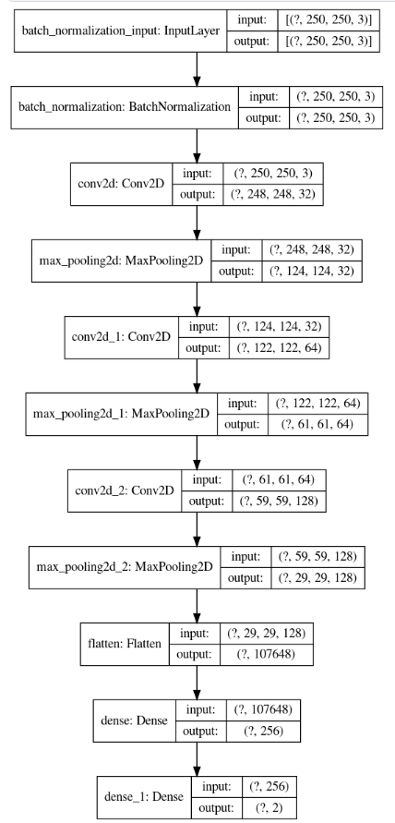
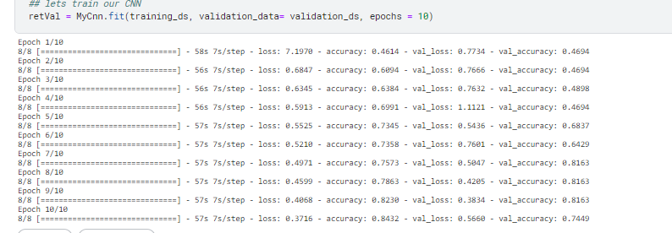

Slide 11
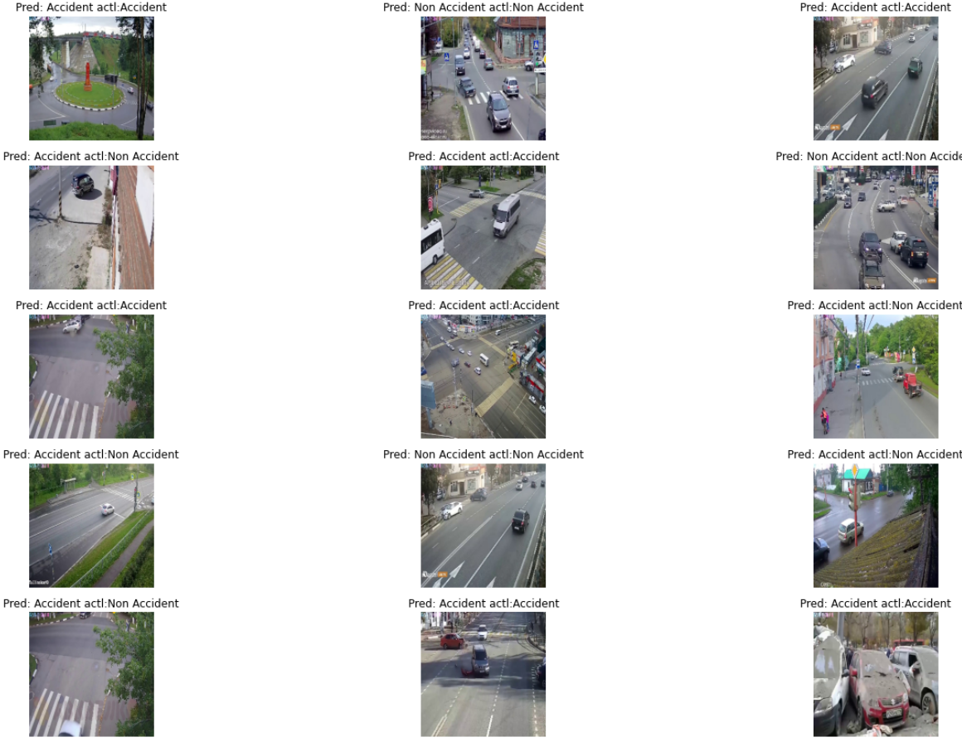
RESULTS
Obtained Model Accuracy:
0.86
Demo link
https://www.kaggle.com/code/mohesh15b/accident-detection-using-cnn
Mohesh-B/Accident-Detection (github.com)
3/21/2024 Annual Review

Slide 12
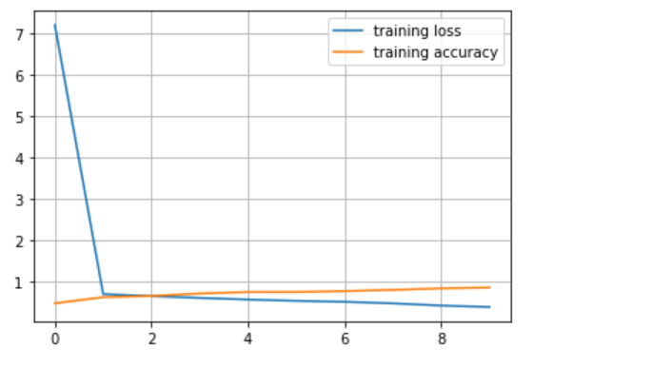
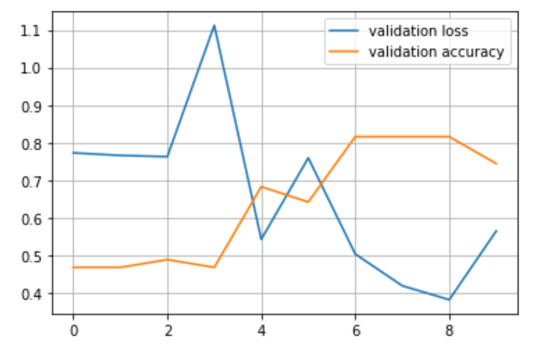
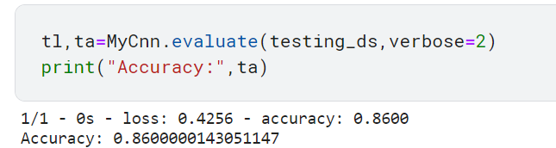
Accuracy of the model

